Slide 1

Psychological Support for Children & Young People with Vision Impairment
Dr Susannah Price
Specialist Clinical Psychologist, Great Ormond Street Hospital for Children
Thanks to FAB Psychologists for slides.

Slide 2
Overview of presentation
Introduction to Fight Against Blindness charity
Landscape of psychological services
Evidence base for psychological support
Key psychological principles and strategies
Questions
Notes:
Note about acronyms:
FAB- fight against blinds
CYP- children and young people
VI- visual impairment

Slide 3
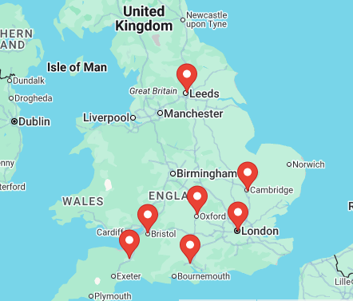
Fight Against Blindness
Charity organisation who fund NHS Clinical Psychologists to work with CYP with visual impairment and eye conditions.
Chairman: Clive Fisher
www.fightagainstblindness.org
Notes:
Bristol Eye Hospital , Leeds Children’s Hospital , Addenbrooke’s Hospital, Cambridge , Southampton General Hospital , Great Ormond Street Hospital , Oxford Eye Hospital , Musgrove Park Hospital, Taunton

Slide 4
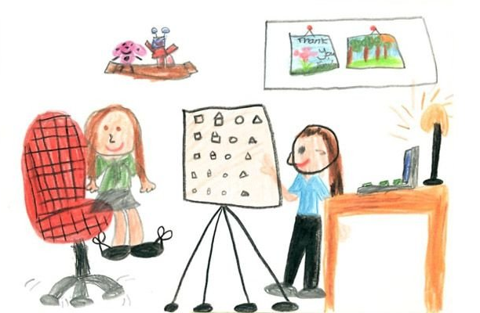
What do FAB psychologists do?
Supporting CYP & families directly
Examples of referral reasons:
Confidence and self-esteem
Low mood or anxiety related to VI
Adherence with treatment
Procedural anxiety
Adjustment and acceptance

Slide 5
Supporting CYP & families directly
Assessment: Finding out about the child, their family and their goal for support
Formulation: Making sense of the child’s experience
Intervention: Can include cognitive behaviour therapy (CBT), acceptance and commitment therapy (ACT), systemic therapy, narrative therapy
Examples of goals:
To talk about difficult emotions
To learn skills for when I am anxious
To understand ways to help our child with vision tests

Slide 6
Supporting CYP & families directly
Cognitive Behavioural Therapy / Acceptance and Commitment Therapy
Identifying unhelpful thought patterns (e.g. everyone is looking at my eye / I’m going to get lost) and trying to adopt more helpful thought patterns.
Managing difficult emotions e.g. breathing exercises to manage anxiety/panic, mindfulness exercises to shift focus to the present moment
Identifying the person’s values and living within these (e.g. It is important to me to be active, how can I do this in a way that fits with my needs?)
Narrative
Helping the person to move away from the idea that something is “wrong” with them and identify examples of when they have coped well
How do I make sense of my experience and who is on my team of solidarity/what are their roles
Systemic
Working with parents/carers to support the process above, as well as helping them to accept/adjust to their child’s diagnosis

Slide 7

Additional work of Psychologists
Work with the system
  Medical team
  QTVIs
  Schools
Teaching & training
Research (McKay & McCubbin, 2024)

Slide 8
What other services are available
Inequitable access to specialist support
Recognition of need for support
What other services may be available?:
  Paediatric psychology services
  Community paediatrics
  Third sector- charities (RNIB, Look)
  School based support
  Child and Adolescent Mental Health Services (CAMHS)
  GP

Slide 9
Why is psychological support important?
What does the research say?
Limited research on the emotional impact of living with VI
Growing evidence base that CYP with VI are more at risk of psychological distress
(McKay & McCubbin, 2024, Augestad, 2017)
Voices of those with VI
(McLean & Gottlob, 2012)

Slide 10
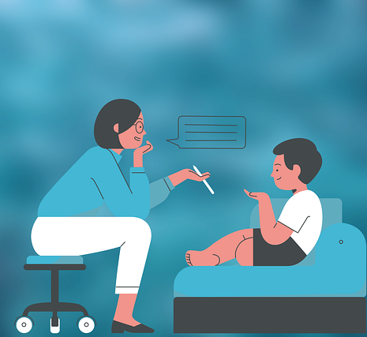
Impact of living with VI
Influencing factors
Nature of diagnosis
Support available to the child
Family context
How they are coping in education
If the child is dealing with other diagnoses
Other factors

Slide 11

Responding to difficult emotions
Emotions, even the hard ones, are normal, important and ok

Slide 12
Visual impairment, emotions and education
Access/engagement with support
Perception of themselves as being different
Managing level of independence/autonomy
Transitions: practical and emotional issues
  Move from primary to secondary
  Late teenage/early adulthood

Slide 13
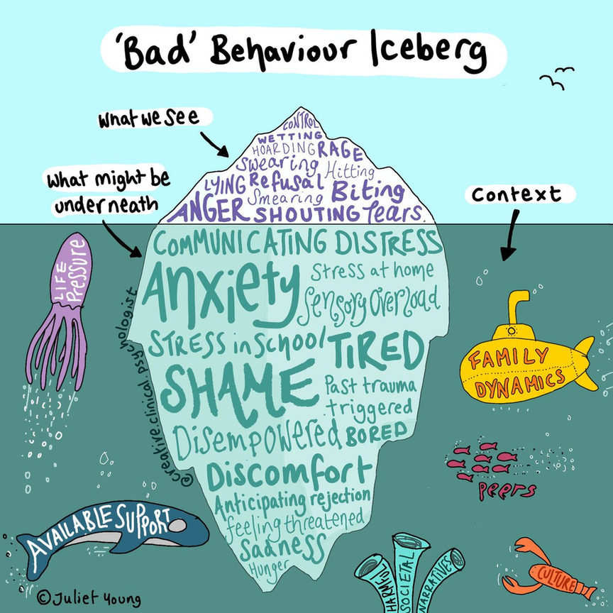
Behaviour is communication
What we see:
  Disruptive
  Withdrawn
  Hyperactive
  Refusal
  Clinging to caregivers
  Uninterested
What we can’t see:
  Thoughts
  Emotions
  Physical feelings
  Attachments to others

Slide 14
Understanding difficulties
Some examples:
Not wanting to be different to peers
Experience of bullying or discrimination
Finding it hard to talk to new people
Feeling unsafe or unsettled in school environment
Difficulties with relationships due to past experiences
Finding the conversation (e.g. eye sight) emotional

Slide 15
Ideas for managing engagement difficulties
‘It seems you’re finding this hard to do, is that right, can you tell me why?’
‘This is really hard, it’s ok to feel X’,
‘Some of the young people I work with think/feel X, I am wondering if that’s the same for you’
‘I know this test is a bit boring but I’m asking you to do it for Xreason whyX and we can do Xfun activityX when we’ve finished’
Naming the difficulties
Validate and normalise
Acknowledge the boring bits
Check in with our expectations
Use CYPs interests
Reduce session length

Slide 16

When to refer for additional support?
What is the day-to-day impact for the CYP?
What is the CYP view about having more support?
Speak with the system around the CYP
What support and resources are already in place?
Notes:
Low mood- changes in sleep, appetite, motivation, difficulty concentrating, loss of interest, feeling hopeless, suicidal thoughts or self-harm
Anxiety- changes in sleep, restless/on edge, avoidance of things/situations, difficult concentrating
What is the set up in your service to discuss when you have concerns about a young person?
Listen to that professional instinct
Image: Photograph of a black signpost with six directional arrows labelled Help, Support, Advice, Guidance, Assistance, and Info against a blue sky with scattered clouds.

Slide 17
Where to refer?
Significant concerns about the CYP mental health
  GP
  Local CAMHS
What else is available in your area?
  School based support
  Paediatric psychology services
  Community paediatrics
  Third sector- charities (RNIB, Look)

Slide 18
References & Resources
Augestad, L. B. (2017). Mental Health among Children and Young Adults with Visual Impairments: A Systematic Review. Journal of Visual Impairment & Blindness, 111(5), 411.
McKay, C., & McCubbin, I. (2026). Investigating psychological distress in children with a visual impairment: The role of parental factors. British Journal of Visual Impairment, 44(1), 141–156. https://doi.org/10.1177/02646196241305553
McLean, R. J., Windridge, K. C., & Gottlob, I. (2012). Living with nystagmus: a qualitative study. British journal of ophthalmology, 96(7), 981-986.
FAB & RNIB podcasts Fight Against Blindness : Podcasts
RNIB- Tough Talks Tough talks – Talking to children about vision impairment
Medical Needs in Schools - For Professionals Working in Education to Assist Young People with Visual Impairments (covers psychological, educational and social impact and guidance for teachers/schools to mitigate these impacts)

