Slide 1
An Overview of the Education Transition Journey for Students with SEND
Caroline Sutton-Reid
carolines@nasen.org.uk
National Coordinator, Whole School SEND (nasen)

Slide 2
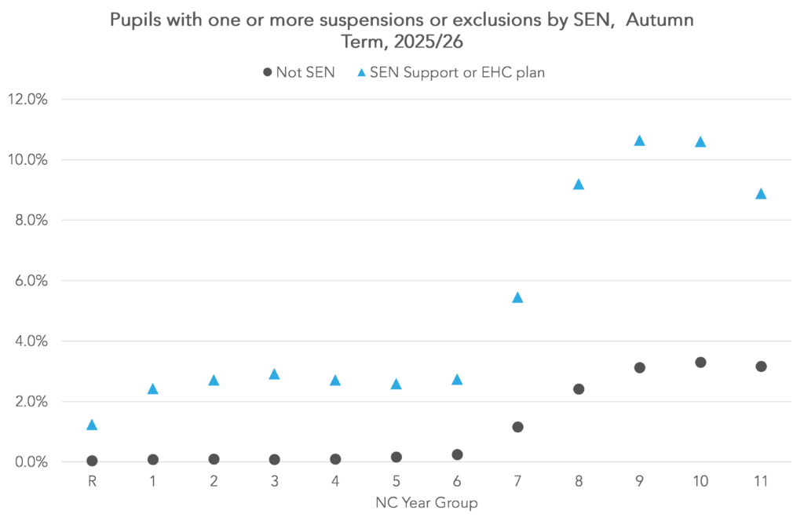
Transitions and the Journey in Education
FFT Education Datalab, Exclusions and Suspensions in Autumn 2025/26, March 2026

Slide 3

Barriers vs. Belonging

Slide 4


An Effective Approach to Transitions
Curriculum continuity
School routines and expectations
Healthy peer networks
Anna Freud Transitions Guidance
EEF Transition Tool

Slide 5
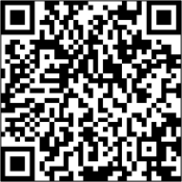
Thank you
Caroline Sutton-Reid
carolines@nasen.org.uk
www.nasen.org.uk
www.wholeschoolsend.org.uk

