Slide 1
The CFVI as a shared approach for supporting transitions
Dr Rachel Hewett
Vision Impairment Centre for Teaching and Research
School of Education
University of Birmingham

Slide 2
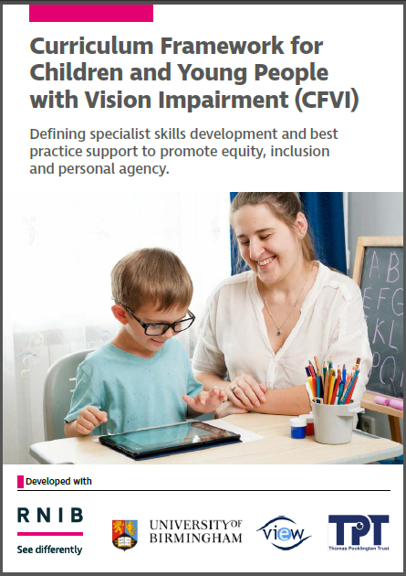
Overview of presentation
Introduction to the CFVI
How has evidence of post-school transitions informed the CFVI?
Collaboration to support transitions
Reflections on importance of CFVI moving forwards

Slide 3
1. Introduction to the CFVI
What is the CFVI?
UK-wide framework was launched in March 2022, revised edition August 2025
Framework for supporting children and young people with VI to access the core curriculum and to develop the broad range of skills needed to learn alongside their peers and live independently in adulthood.
Clarifies and defines interventions, best practice support and the range of skills that are essential for children and young people with VI to develop.
Offers a shared vocabulary for specialist and non-specialist education professionals, children and young people with vision impairment and their families.
Provides a roadmap to a more inclusive education for children and young people with vision impairment.
A framework for all - not just for specialists

Slide 4
1. Introduction to the CFVI
Access to Learning – Learning to Access Model (McLinden et al, 2016).
Model of education that recognises the importance of ensuring that children and young people with vision impairment have access to the school curriculum, whilst also ensuring that they have opportunity to develop the skills and experiences needed to promote their independence.
What are the implications of the model?
Over time the emphasis will shift from educational interventions to support access to learning and instead focus on interventions which support the child in learning to access.
Focus on the end point – what skills and experience do we want the YP to have once they leave education?

Slide 5
2. How has evidence of post-school transitions informed the CFVI?
Longitudinal Transitions Study
  Tracked 80 young people with VI through post-school transitions for 11-years
  Identified factors linked to positive transitions:
    demonstrated the importance of specialist support and the development of specialist skills and experiences as captured in the CFVI
  Also highlighted vulnerability to becoming long-term NEET
    Case study of Chloe

Slide 6
2. How has evidence of post-school transitions informed the CFVI?
Careers Education Information and Guidance study
  Investigated CEIAG provision for CYP with VI from the perspective of YP and QTVIs
  Highlighted the importance of inclusive yet tailored guidance
  CYP with VI not eligible for an EHCP vulnerable to not receiving any tailored guidance
  Barriers to work experience > difficult messaging to YP

Slide 7
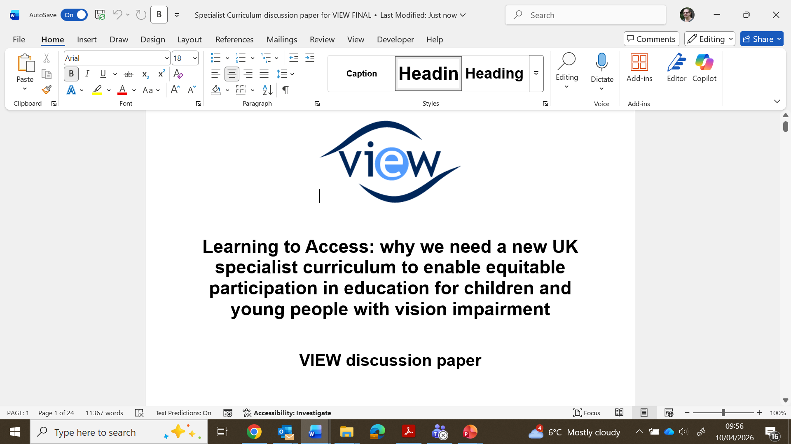
2. How has evidence of post-school transitions informed the CFVI?

Slide 8
2. How has evidence of post-school transitions informed the CFVI?
Active child/young person
1. Facilitating an inclusive world
4. Literacy
7. Accessing information
8. Technology
5. Habilitation: orientation and mobility
6. Habilitation: independent living skills
9. Health - social, emotional, mental and physical wellbeing
2. Sensory development
10. Social, sports and leisure
3. Communication
11. Preparing for adulthood

Slide 9
2. How has evidence of post-school transitions informed the CFVI?
“The framework supports children and young people up to the age of 25, reflecting the importance of both early intervention and in anticipation of the preparation needed to support and resource the child/young person into adulthood” (p4).
Area 11: Preparing for Adulthood
  “…recognises the importance of support children and young people to prepare for their lives after compulsory education… The contents of this area need to be taken into consideration throughout the child/young person’s life, to ensure that everything is in place for them to have a successful transition into adulthood”.
Recognises that services might not support into adulthood, but rather the importance of anticipation of need.

Slide 10
2. How has evidence of post-school transitions informed the CFVI?
Area 11 ‘Preparing for adulthood’ - Examples of targeted intervention approaches:
Providing support in preparation for key post compulsory education transitions
Specialist input to careers education, information and guidance
Supporting YP in taking personal responsibility
Entitlement and benefits (incl. transfer to adult services)
Facilitating more complex transitions
Supporting skills and knowledge of key community services
Housing
Wider relationships (e.g. house share, romantic relationships, parenthood)

Slide 11
3. Collaboration to support transitions
Collaboration is at the heart of the CFVI – not just for specialists
“To aid discussion, understanding and collaboration amongst all involved in a child / young person’s education of how and when these skills should be taught by suitably qualified specialists and reinforced by non-specialists”.
“A UK-wide framework allows colleagues across the sector to ensure the needs of children and young people with vision impairment are being met across all outcome areas.”

Slide 12
4. Reflections on importance of CFVI moving forward
SEND reform in England, with more responsibility placed on schools
  Important that the holistic needs of the children and young people with vision impairment are remembered
More important than ever
  Difficult landscape for CYP in general
  Specific needs of CYP with VI can more easily be overlooked

Slide 13
4. Reflections on importance of CFVI moving forward
The transformative power of having the right support
“I can’t really emphasise how helpful she has been, to be honest. Because she has been consistent since when I was 14 all the way to now, she has always been a support through uni and everything, when I was at [college], finding me these work placements that I did, thinking about when I graduate, she was on the ball… She would help me with my job search and finding somewhere to live if I needed something. So she was a really valuable resource that I have been able to tap into.”
(Young person sharing their experience of working with a Transitions Officer)

